Slide 1

Rechnerarchitekturen für Deep-Learning Anwendungen (RADL)
Dustin Heither, Maximilian Achenbach, and Robert Kagan
Optimizing Deep Learning Performance:
A Hybrid CPU-GPU Framework with Multithreading, SIMD,
and Evaluation of Efficiency Metrics

Slide 2
Outline
6. Presentation
01
Tweaks & Enhancements
02
Hardware & Benchmark
03
CUDA Tuning
04
Multithreading
05
Quantization
06
Outlook

Slide 3
Tweaks & Enhancements
Overview
Optimizing Code Efficiency
Goal: Reduce code complexity and binary size
Solution: Removed unused functions
Improving Data Processing Speed
Goal: Eliminate unnecessary transformation step
Solution: Integrated transpose into flatten
Clang and C++11 Extensions
Goal: Reduce boilerplate and boost functionality
Solution: Use clang-specific and C++11 features
DATA_TYPE *malloc_cuda(int N, int M) {
size_t bytes = N * M * sizeof(DATA_TYPE);
DATA_TYPE *d_matrix;
cudaMalloc(&d_matrix, bytes);
return d_matrix;
}
for(int i = 0; i < a->x / len; i++) {
for(int j = 0; j < a->y; j++) {
for(int m = 0; m < len; m++) {
int idx = i * a->y * len + j * len + m;
c->m[get_idx(0, idx, c->y)] = a->m[get_idx(i, j, a->y) + m * ((a->x / len) * a->y)];
}
}
}

Slide 4
Hardware & Benchmark
Hardware
CPU | Release date | TDP (W) | Number of (performance) cores | Number of threads
AMD Ryzen 7 3800XT | 7. Juli 2020 | 105 | 8 | 16
Apple M3 Pro 11-Core | 30. Oktober 2023 | 27 | 5 | 11
Intel Core i7 1065G7 | 1. Juni 2019 | 15 | 4 | 8
GPU | Release date | TDP (W) | Number of CUDA cores | Base Clock (MHz)
NVIDIA GeForce RTX 2080 | 20. September 2018 | 215 | 2944 | 1515
NVIDIA GeForce MX350 | 10. February 2020 | 20 | 640 | 1354

Slide 5
Hardware & Benchmark
Benchmark
Batch size: 1
Epochs: 10
Unit:
Total time
In microseconds (µs)
Averaged over 12 runs
Discarding first 2 runs
Lower is better
Old:
Last presentation
Quantization:
Data type: int32
XL:
Image dimensions: (32x30)²
XXL:
Image dimensions: (64x30)²
5

Slide 6
CUDA Tuning
Overview
Removed transposing of fc_weights:
Change: Eliminated unnecessary transposition of fully connected layer weights
Benefit: Reduces overhead and improves memory efficiency
Implemented CUDA Shared Memory for Matrix Multiplication:
Change: Implemented shared memory utilization for XL matrix multiplication
Benefit: Boosts computational efficiency on CUDA hardware
Eliminated cudaDeviceSynchronize call:
Change: Removed an unnecessary synchronization call in CUDA code
Benefit: Reduces latency and enhances execution performance

Slide 7
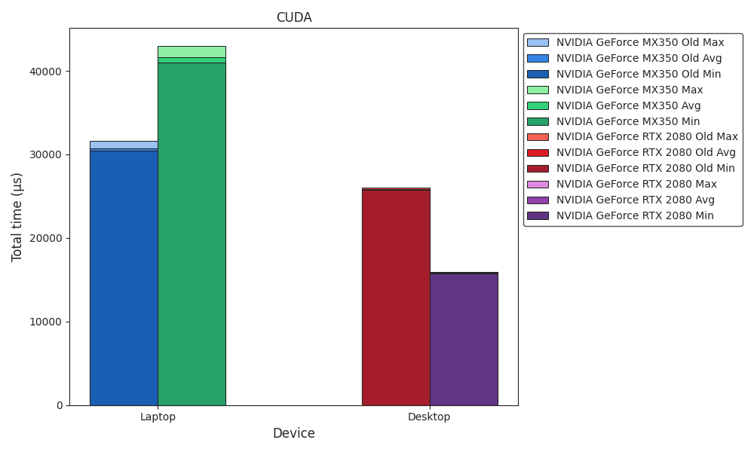
Benchmark
CUDA

Slide 8
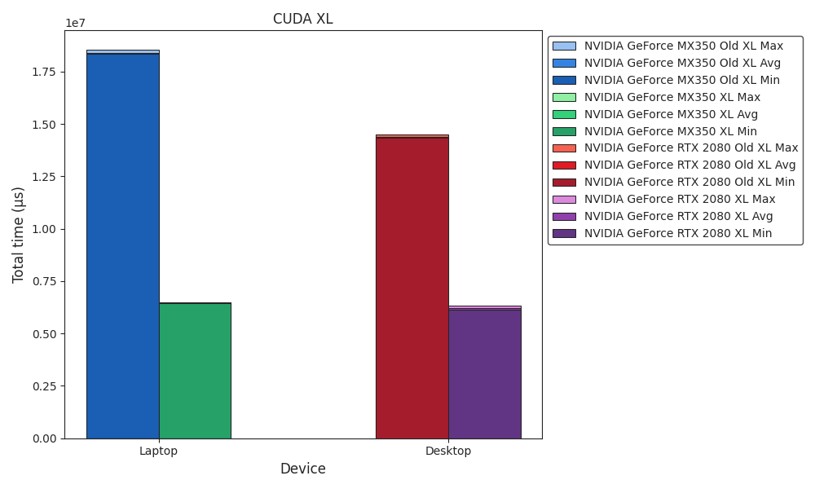
Benchmark
CUDA XL

Slide 9
Multithreading
1 / 3
Separated NVIDIA, OpenMP, and Multithreading
Change: Modularized different parallel frameworks
Benefit: Clearer separation and easier maintenance
Fixed Smart Multithreading
Change: Refined adaptive thread management logic
Benefit: More robust and efficient multithreading
__attribute__((always_inline)) inline void run_nvidia(int i);
__attribute__((always_inline)) inline void run_omp(int i);
__attribute__((always_inline)) inline void run(int t, int i);
mt_arg arg[instance->THREADS];
for(int i = 0; i < c->x; i++) {
for(int j = 0; j < instance->THREADS; j++) {
arg[j].a = &a;
arg[j].b = &b;
arg[j].c = &c;
arg[j].i = i;
if(instance->THREADS < c->y) {
arg[j].single_core = 1;
instance->matmul_mt(&arg[i]);
break;
}
arg[j].single_core = 0;
arg[j].start_routine = instance->matmul_mt_wrapper;
instance->push_mt(&arg[j]);
}
if(instance->THREADS >= c->y) {
instance->wait_mt();
}
}

Slide 10
Multithreading
2 / 3
Implemented Dedicated Multithreading Class
Change: Centralized thread management in one class
Benefit: Improved reusability and consistency
Merged Multithreading Files into New Class Constructor
Change: Combined two separate multithreading files into one unified class constructor
Benefit: Simplified initialization process and improved maintainability
class mt {
public:
int COUNTER;
int THREADS;
GAsyncQueue *queue;
pthread_cond_t cond;
pthread_mutex_t mutex;
pthread_t tids[(int)(CHAR_BIT * sizeof(void*))];
mt() : mt(1) {}
mt(int threads) {
COUNTER = 0;
THREADS = threads;
queue = g_async_queue_new();
pthread_mutex_init(&mutex, NULL);
pthread_cond_init(&cond, NULL);
mt_struct arg[THREADS];
for(int i = 0; i < THREADS; i++) {
arg[i].instance = this;
arg[i].idx = i;
pthread_create(&tids[i], NULL, start_mt, &arg[i]);
}
wait_mt();
}
~mt() {
mt_arg arg[THREADS];
for(long i = 0; i < THREADS; i++) {
arg[i].start_routine = stop_mt;
push_mt(&arg[i]);
}
for(long i = 0; i < THREADS; i++) {
pthread_join(tids[i], NULL);
}
pthread_cond_destroy(&cond);
pthread_mutex_destroy(&mutex);
g_async_queue_unref(queue);
}
}

Slide 11
Multithreading
3 / 3
Implemented Multithreaded Image Processing
Change: Introduced a concurrent image processing pipeline
Benefit: Enhanced performance through parallel processing
#ifndef IMG_HPP
#define IMG_HPP
#include "tf.hpp"
#ifndef NVIDIA
__attribute__((always_inline)) inline void process_images(void *instance, mt_arg *arg) {
mt *parent_instance = (mt*)instance;
mt child_instance(parent_instance->THREADS);
// malloc
for(int i = arg->idx * (arg->io->image_len / parent_instance->THREADS); i < ((arg->idx + 1) * (arg->io->image_len / parent_instance->THREADS)) + (arg->idx == parent_instance->THREADS - 1 ? arg->io->image_len % parent_instance->THREADS : 0); i++) {
// tf
}
// free
parent_instance->wait_mt();
}
#endif
#endif

Slide 12
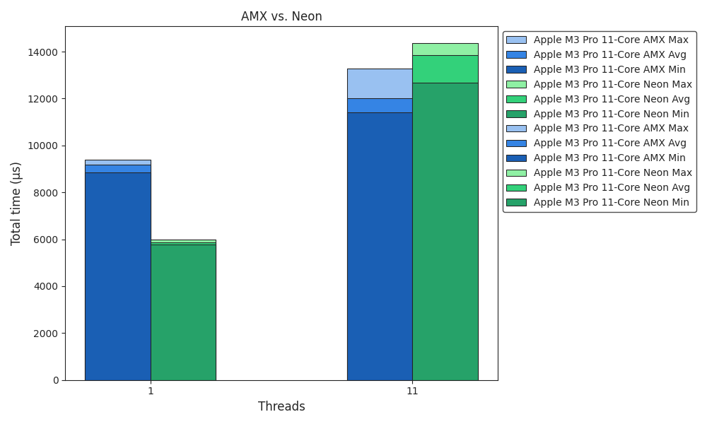
Benchmark
AMX vs. Neon

Slide 13
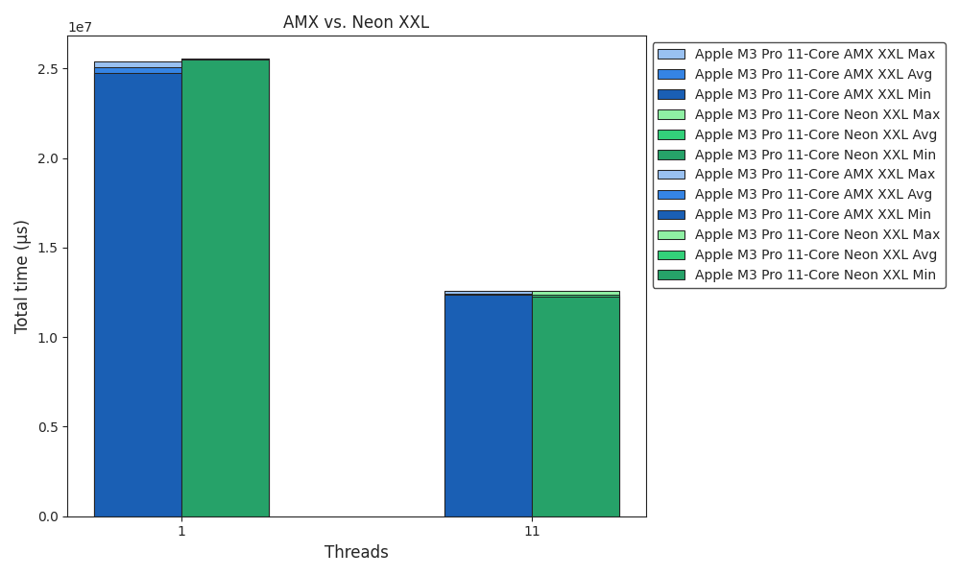
Benchmark
AMX vs. Neon XXL

Slide 14
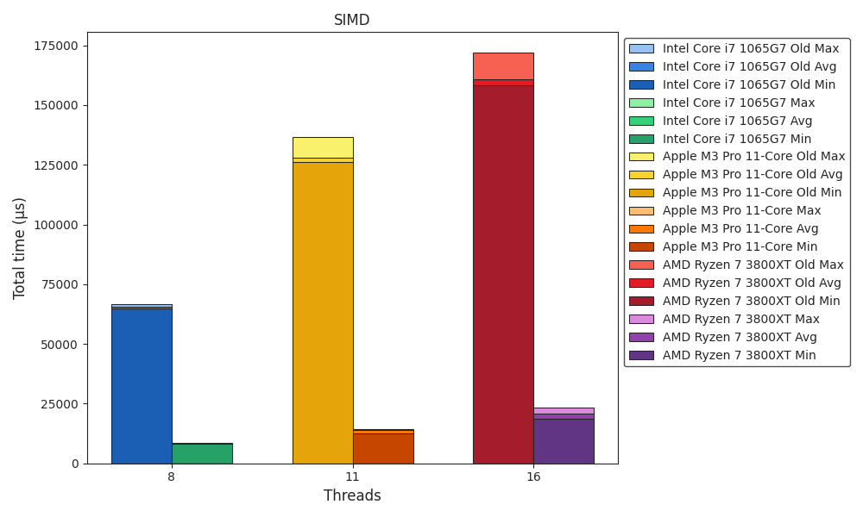
Benchmark
SIMD

Slide 15
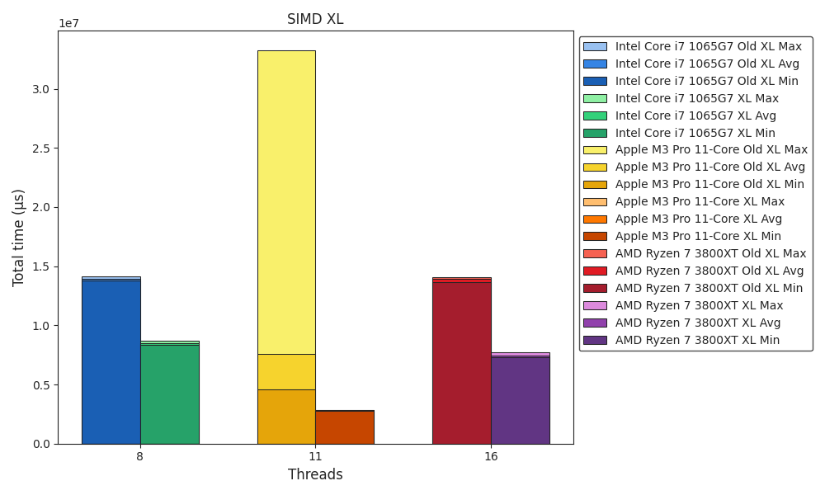
Benchmark
SIMD XL

Slide 16
Quantization
Overview
Quantization in export_image.py and export_xl.py
Change: Implemented quantization in image export scripts
Benefit: Reduces file size and memory usage for exported images
Quantization in tf.py
Change: Integrated quantization into the training process
Benefit: Improves model efficiency and reduces inference time
Fixed quantized SIMD
Change: Corrected SIMD-based quantization
Benefit: Enhances performance and accuracy of vectorized computations
Exported quantized weights
Change: Saved model weights in a quantized format
Benefit: Reduces storage requirements and speeds up model loading

Slide 17
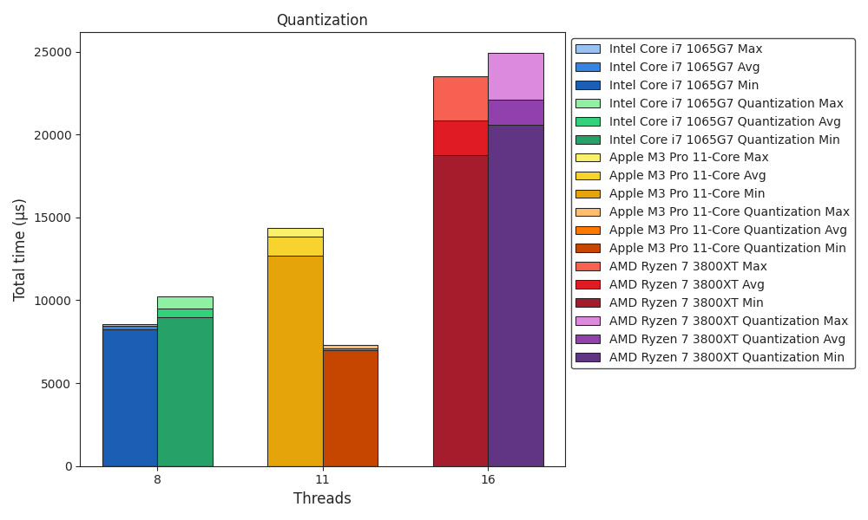
Benchmark
Quantization

Slide 18
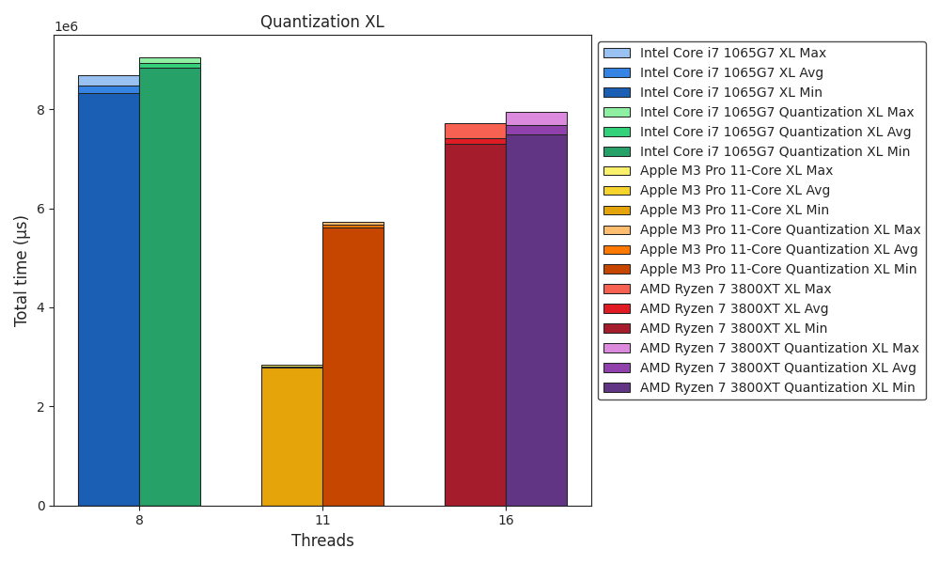
Benchmark
Quantization XL

Slide 19
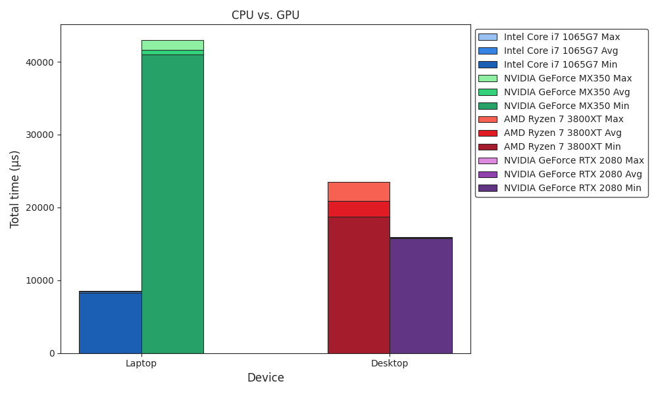
Benchmark
CPU vs. GPU

Slide 20
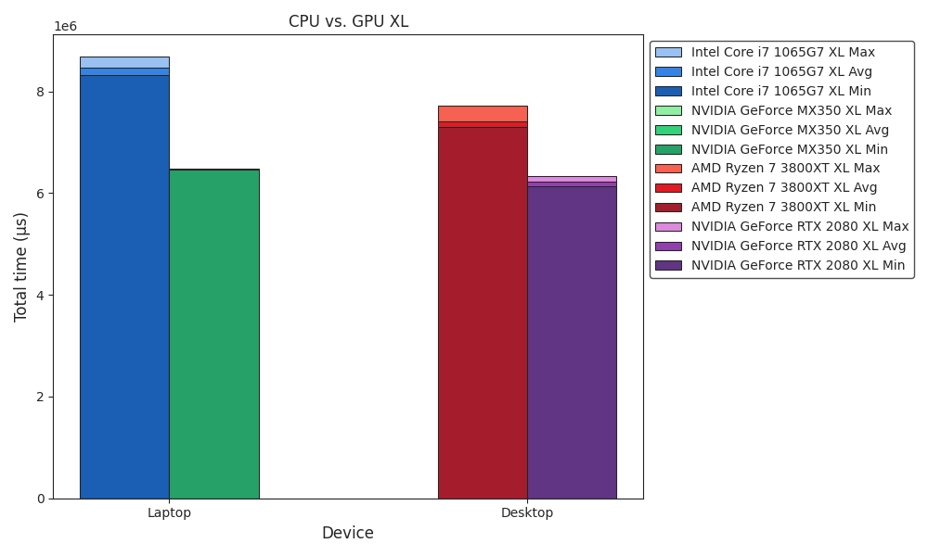
Benchmark
CPU vs. GPU XL

Slide 21
Outlook
Overview
Work Completed ✅
One Framework
CUDA Tuning
ICPX vs. Clang Comparison
OpenMP Integration
Multithreading Optimization
SIMD Implementation
Quantization Support
To Do‘s 🚧
Final Presentation
Final Paper Submission 💀

